Slide 1
Special Topic-I
PLL Basics and Design

Slide 2
What is it?
PLL = Phase Lock Loop
A circuit which synchronizes an adjustable oscillator with another oscillator by the comparison of phase between the two signals.
An electronic circuit that synchronizes itself to an external reference signal.

Slide 3
What is it for?
To generate High Frequency Clock in Microprocessor.
In Mobile Communication to generate Carrier Frequency.
Can you think of any other Application? Actually there are many.

Slide 4
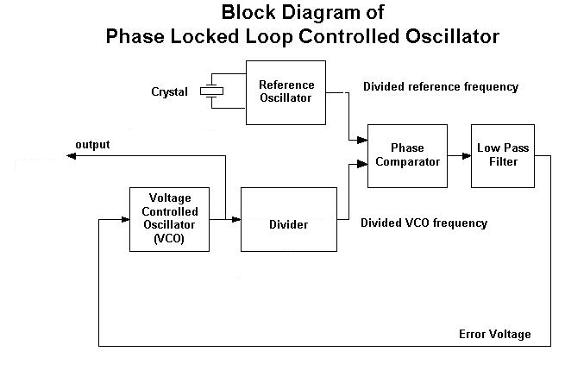
Basic Block Diagram

Slide 5
1.Voltage Controlled Oscillator (VCO)
What it does?
Requirements:
  High Frequency Operation
  Good Programmability Range
  Less sensitive to environment
Basic Model: Fout = K * Vin
Different Oscillators in literature. How to Select?
A simple Example: Ring Oscillator
Common Challenges:
  Programmability Range ( Giga-Hertz Order)
  Maximum Noise limit

Slide 6
2. Divider
What it Does?
Requirements:
  Should work on High Frequency( Giga Hertz Order)
  Should be less power Consuming
Challenges:
  Power Consumption (Power is proprotional to frequency)
  Switching Speed.

Slide 7
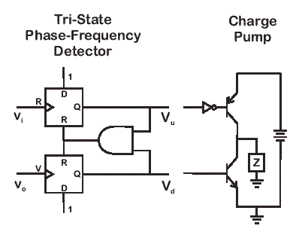
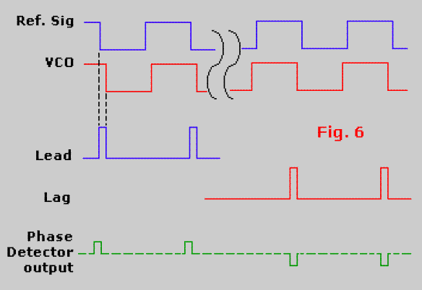
3. Phase-Frequency Detector (PFD)
What it does?
Requirement:
  High Sensitivity
  Moderate Frequency Operation
Challenges:
  Linearity of PFD
  Gain of PFD

Slide 8
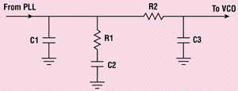
4. Loop Filter
Functionality
Low pass filter
Filters out noise of PLL loop

Slide 9
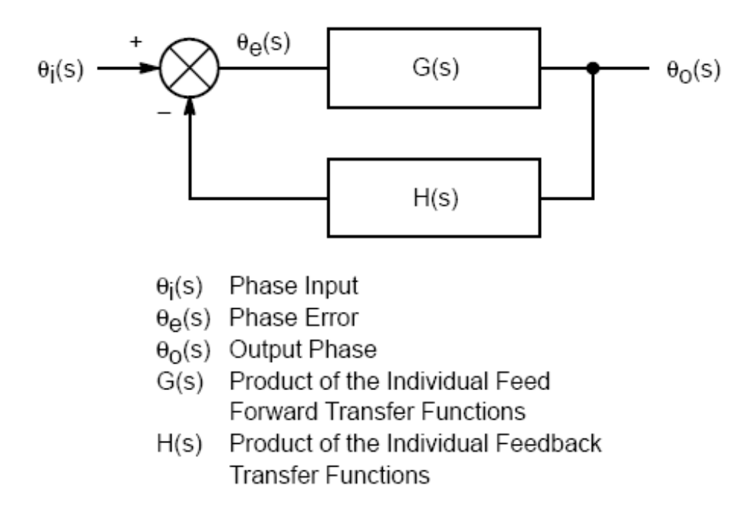
Control Model of PLL

Slide 10
Some definitions:
Order of PLL – Highest degree of polynomial of characteristics equation (1+ G(s)H(s))
Type of PLL – No of poles of loop Transfer function (G(s)H(s)) locate at origin

Slide 11
Food for Thought
What will be the resolution in terms of frequency of PLL? How will you increase it?
What changes you need to do to achieve above goal?
What will be specifications of PLL?
What is the performance metric of VCO?
  For Microprocessor?
  For Transmitter/Receiver IC?

Slide 12
Questions?

